Slide 1

Introduction to R
and the tidyverse
Sigma Xi Workshop
Fall 2025
plombard@endicott.edu

Slide 2

Workshop Files
https://tinyurl.com/sigmaxi2025
Select
Download Zip
Extra All Contents to your Desktop

Slide 3
Getting Started
Create directory for the workshop
Open R Studio, start an “R Project”
Get the files and set up

Slide 4
Greetings from R
Overview:
R Studio window panes
What is a .qmd-file?

Slide 5
Outline of topics
Viewing and summarizing data
Modifying data frames with dplyr
Visualizing data with ggplot2
Running statistical tests (base R)

Slide 6
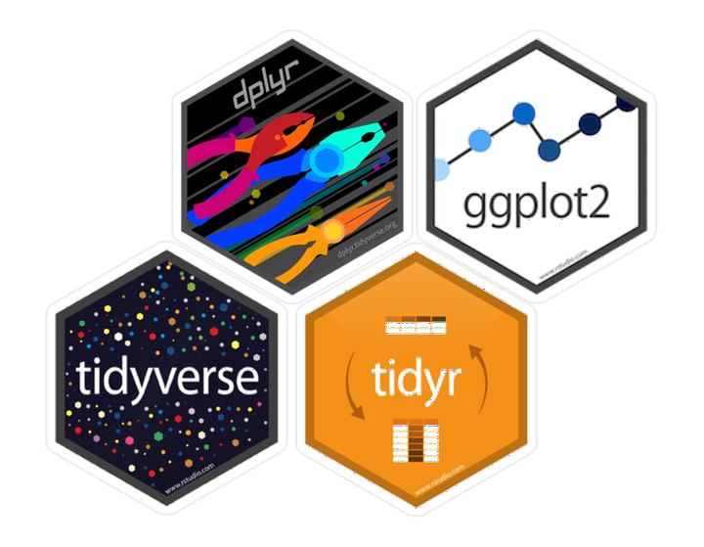
Introducing the tidyverse

Slide 7
Quick note: piping
In the tidyverse we have a “piping” operator that makes code easier to read:
%>%
Basic Idea:
fxn2(fxn1(x)) can be written
x %>%
fxn1() %>%
fxn2()
Whatever gets “piped” goes into the first argument of the next function.

Slide 8
Quick note: piping
In the tidyverse we have a “piping” operator that makes code easier to read:
%>%
Basic Idea:
round(mean(x),4) can be written
x %>%
mean() %>%
round(4)
Whatever gets “piped” goes into the first argument of the next function.

Slide 9

Summarizing and Modifying Data

Slide 10
Summarizing
summarize(summary_name = fxn(column_name) ) E.g., summarize(mean_bpm = mean(bpm))
We can break up by grouping variables by including group_by(var) in the pipe.

Slide 11
Modifying data frames
The dplyr package gives us a “language” for modifying data frames:
select() the columns you want
filter() the rows you want
mutate() the dataframe to create new variables.

Slide 12
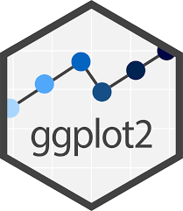
Making Visualizations

Slide 13
Painting and plotting

Slide 14
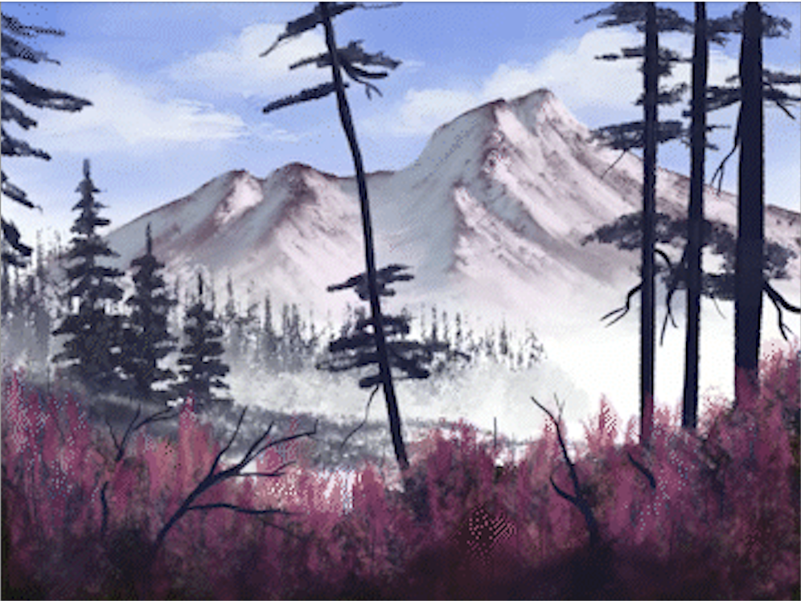
Painting and plotting
Think in layers!

Slide 15
Components of a ggplot
ggplot() creates a “canvas”, links data frame
aes() aesthetics depend on data
geom_point() add geometries to visualize (many options, not just point)
Bells and whistles…

Slide 16
Language of plotting
Prepare your data frame (tidyr and dplyr)
Start your ggplot() with data= and aes()thetics
Add geom_*-etries to visualize the data
Consider more aes()thetics for extra effect
scale_* your aesthetics
label your axes and create titles with labs()
Finishing touches with themes, and patchwork plots together!

Slide 17
Language of plotting (code)
ggplot( )
data = iris,
aes(x = Petal.Width, y = Sepal.Width)
+
geom_point( )
aes(color = Species)
+
scale_color_brewer(“Species of\nIris”, palette=”Set1”)
+
labs(x="Petal Width (in)",
y="Sepal Width (in)",
title="Comparing Sepal and Petal Width by Species of Iris")
+
theme_bw()

Slide 18
Plotting in stages!

Slide 19

Spotify Music
https://tinyurl.com/kaggle-spotify

Slide 20
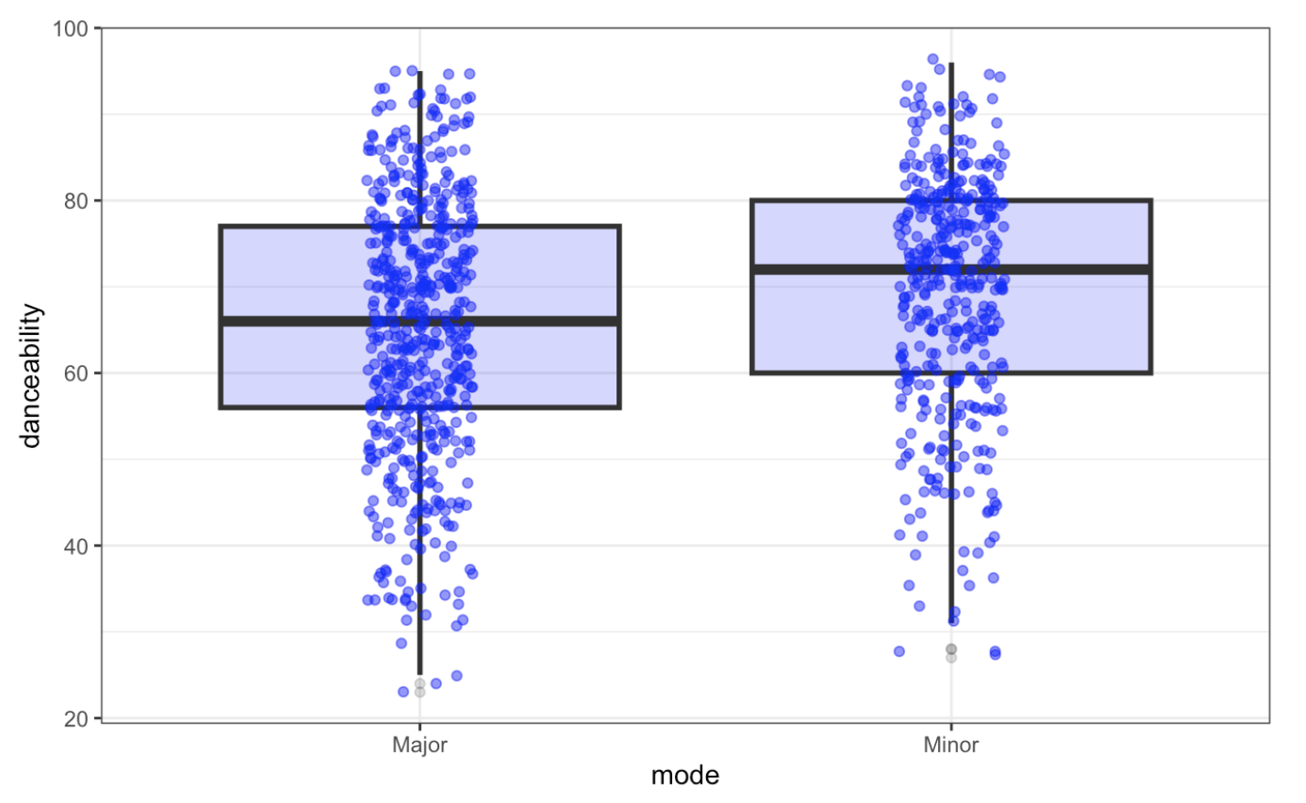
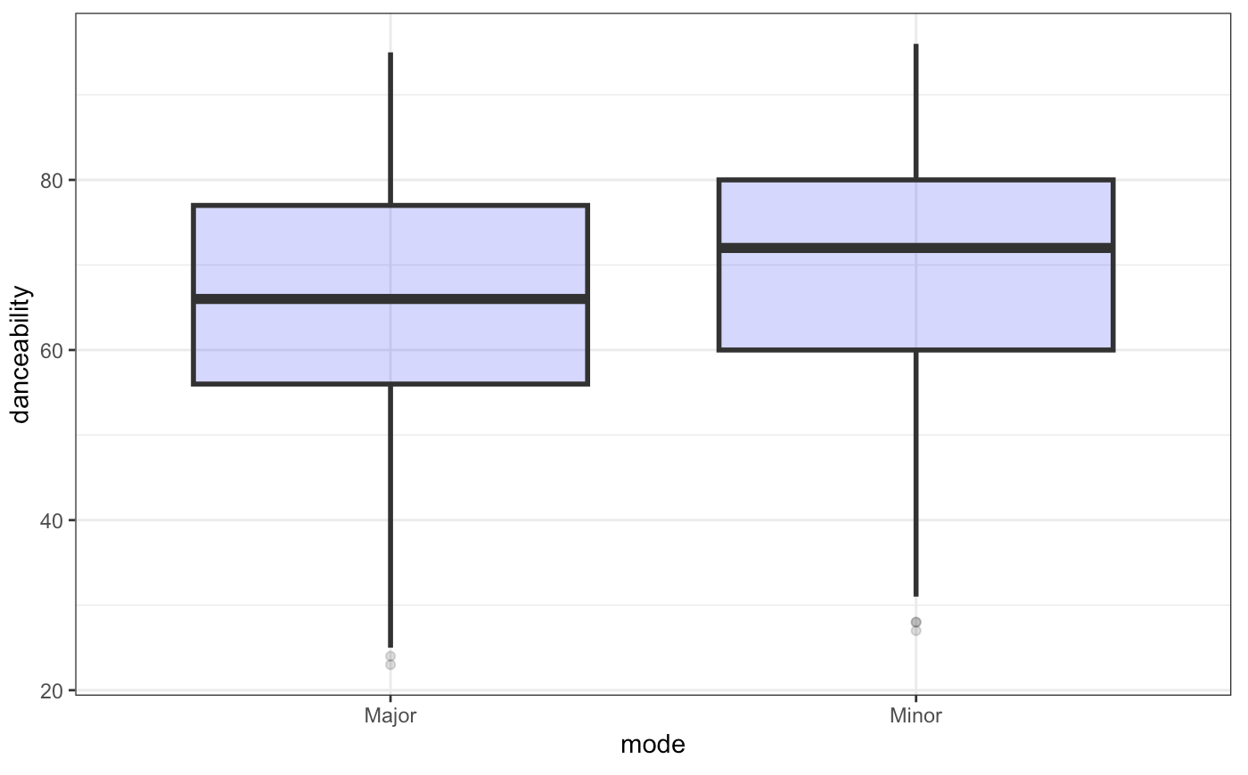
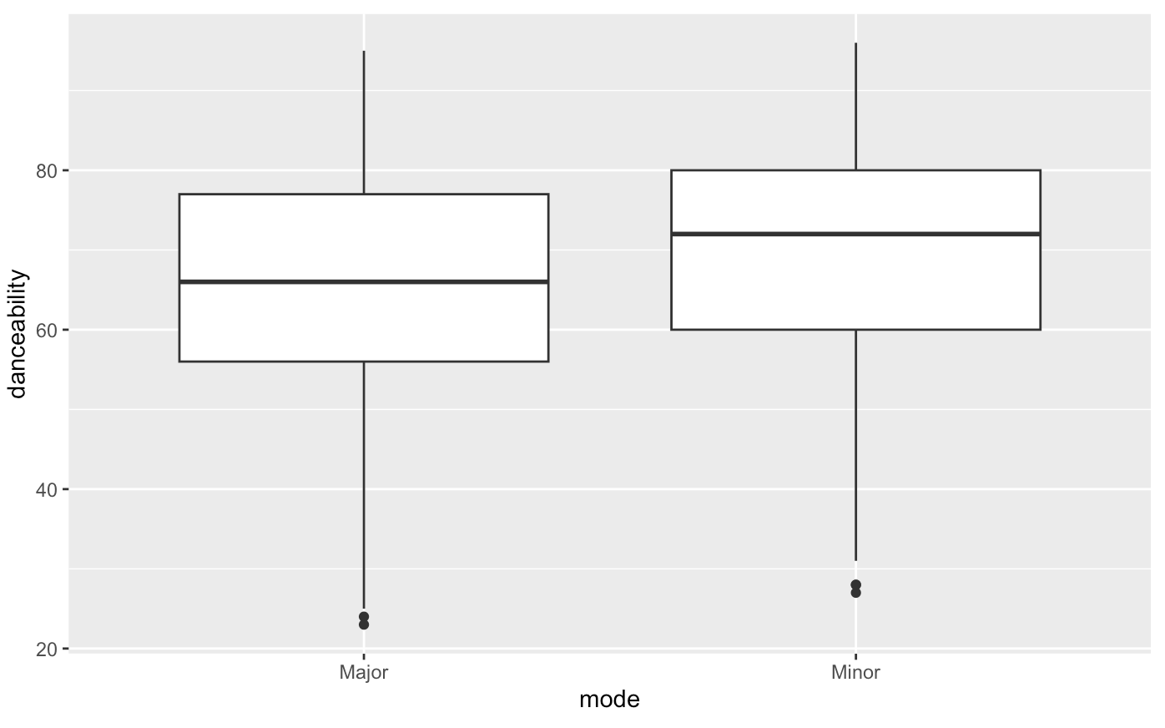
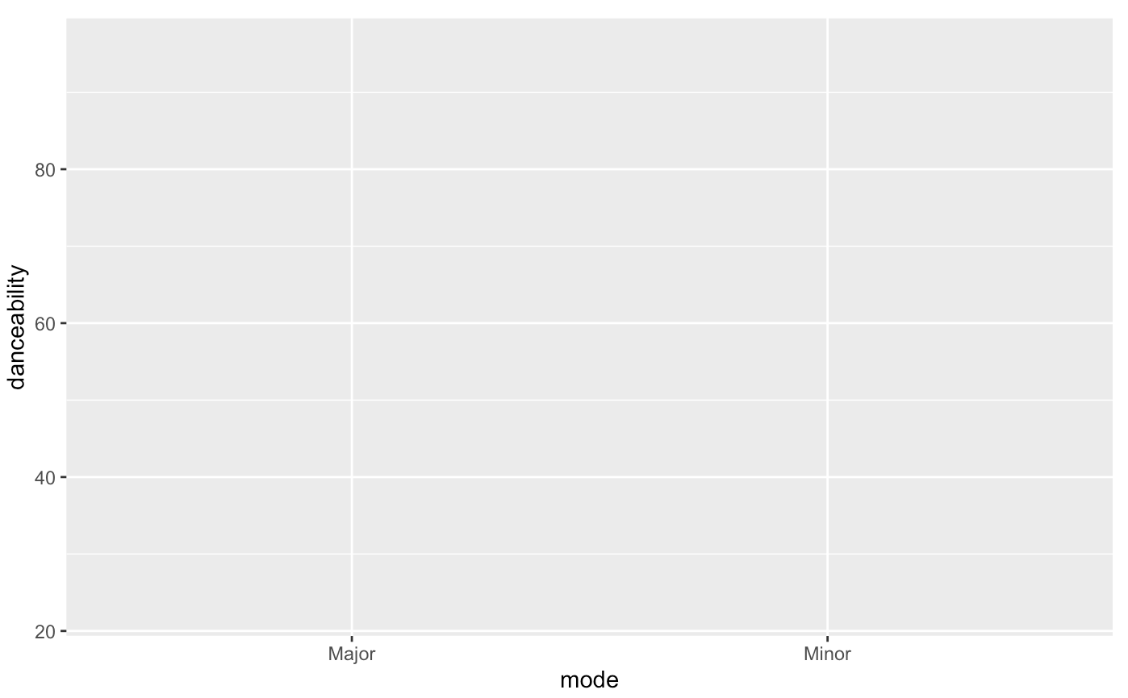
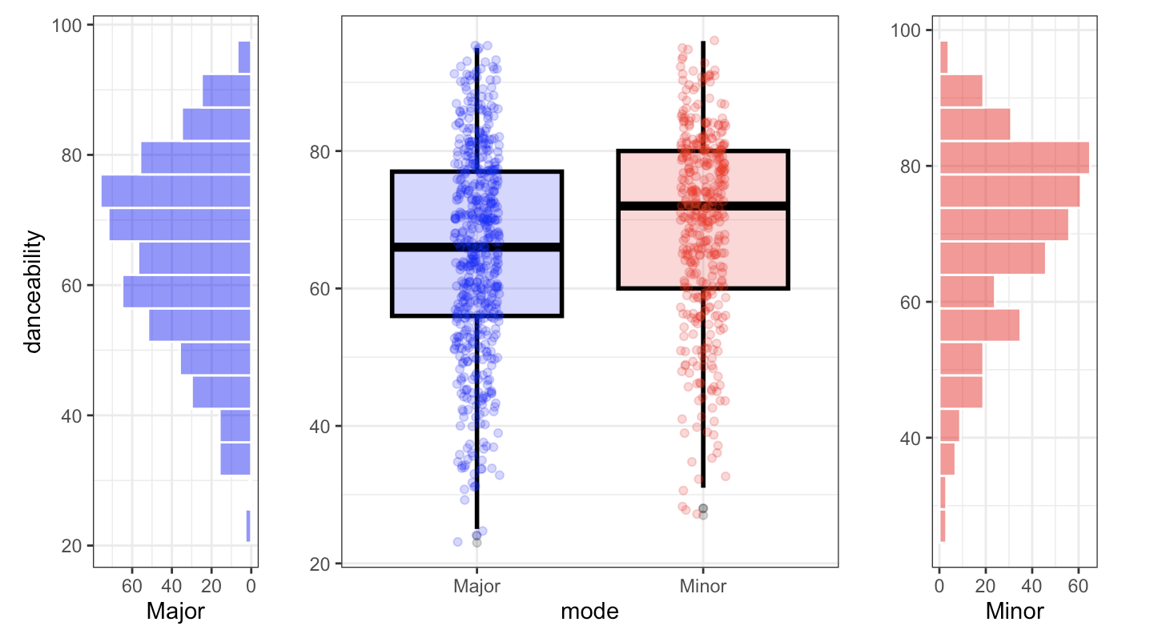
Spotify Music

Slide 21
Statistical testing
Base R statistical functions:
Categorical data: prop.test(), chisq.test()
Mean comparison by groups: t.test(), aov()
Correlation, linear regression: cor.test(), lm()
More tests available in other packages… the sky is the limit!

Slide 22
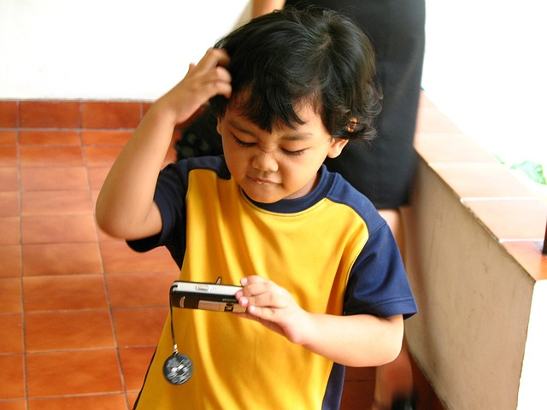
Questions?

Slide 23
Links and Resources
Presentation Materials
GitHub Repository (code and data)
Package documentation
tidyverse documentation
ggplot documentation
tidyr documentation
dplyr documentation
patchwork documentation
Data Repositories
Posit Cheatsheets
Tidyverse Resources
Dr. Rasco Free Videos
SPSP free videos in R

